Slide 1
CODE OPTIMIZATION
Program transformation technique to improve the intermediate code by consuming fewer resources.
Characteristics
Correct-it must not change the meaning of the program.
increase the speed and performance of the program.
The compilation time must be reasonable.
The optimization process should not delay the overall compiling process.

Slide 2
Types of Code Optimization
Machine Independent Optimization –
improves the intermediate code to get a better target code.
The part of the intermediate code which is transformed does not involve any CPU registers or absolute memory locations.
Machine Dependent Optimization –
Done after the target code has been generated and when the code is transformed according to the target machine architecture.
It involves CPU registers, may have absolute memory references .

Slide 3
PRINCIPLE SOURCES OF CODE OPTIMIZATIONS
A transformation of a program is called local if it can be performed by looking only at the statements in a basic block; otherwise, it is called global.
Two types
Function preserving transformations
Loop optimizations

Slide 4
Function Preserving Transformations
Common sub expression elimination
Copy propagation,
Dead-code elimination
Constant folding
Common Sub expression Elimination
An occurrence of an expression E is called a common sub-expression if E was previously computed, and the values of variables in E have not changed since the previous computation.

Slide 5
2. Copy Propagation
Assignments of the form f : = g called copy statements
Copy propagation means use of one variable instead of another.
Example-
x=Pi;
A=x*r*r;
After optimization
A=Pi*r*r;

Slide 6
3. Dead Code Elimination
A variable is live at a point in a program if its value can be used subsequently
Dead Code are statements that compute values that never get used.
Example
i=0;
if(i=1) //dead code
{
a=b+5;
}

Slide 7
4. Constant Folding
Computing the value of an expression which is a constant and using the constant instead is known as constant folding.
Example
a=3.14157/2 can be replaced by
a=1.570

Slide 8
LOOP OPTIMIZATIONS
The running time of a program may be improved if the number of instructions in an inner loop is decreased.
Types of loop optimizations
Code motion-moves code outside a loop
Induction-variable elimination-replace variables from inner loop.
Reduction in strength- replaces expensive operation by a cheaper one.

Slide 9
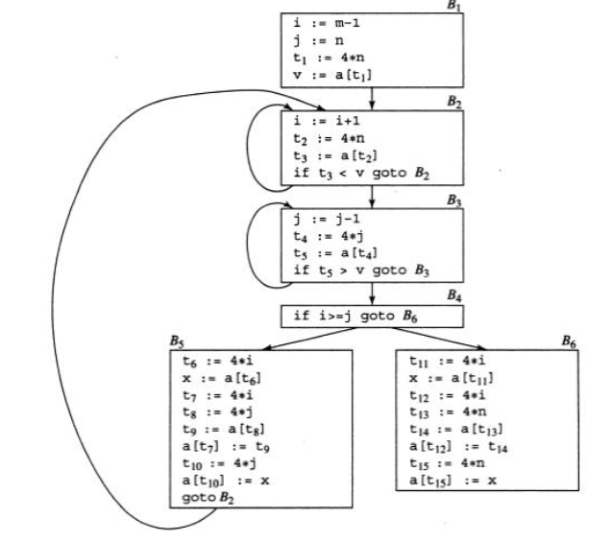

Slide 10
Code Motion
Reduces amount of code inside loop
Takes an expression that yields the same result independent of the number of times a loop is executed (a loop-invariant computation) and places the expression before the loop.
Example
while(i<u-9)
{ // code }
Can be replaced by
j=u-9
while(i<j)
{// }

Slide 11
2. Induction Variables
It gets increased or decreased by a fixed amount on every iteration of a loop .
Variables can get eliminated or strength reduction can be done.
3. Reduction in strength
Replace expensive operations by cheaper ones

Slide 12
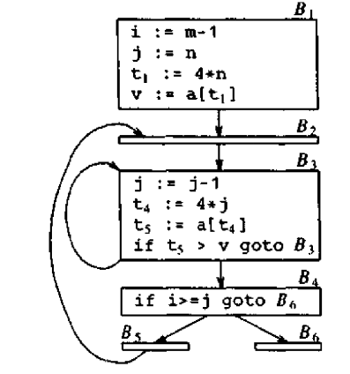
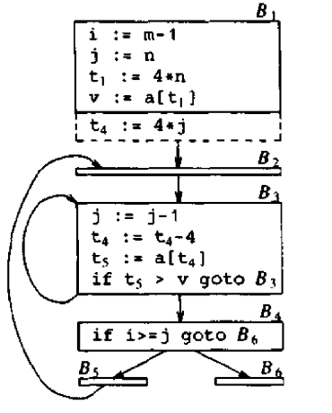
Example

Slide 13
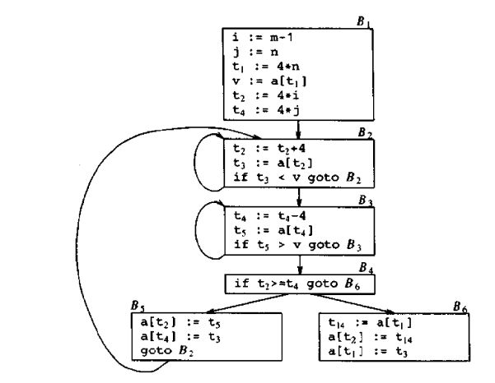
After Induction variable elimination

Slide 14
INTRODUCTION TO GLOBAL DATA FLOW ANALYSIS
Data-flow analysis is a technique for gathering information about the possible set of values calculated at various points in a computer program
Based on optimization techniques used so far.
Data flow equation
out [S] = gen [S] U ( in [S] - kill [S] )
The information at the end of a statement is either generated within the statement , or enters at the beginning and is not killed as control flows through the statement.

Slide 15
Factors affecting data flow equations (out)
1.Values generated –gen
2.Values got as input-in
3. Values removed-kill
Sometimes ‘in’ will also be computed.
Equations are framed based on basic blocks where there is single and unique entry and exit point for the blocks.

Slide 16
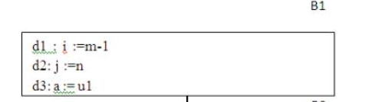
Points and Paths:
Points –entry and exit points
B1 has four points: one before any of the assignments and one after each of the three assignments.

Slide 17
Paths
A path from p1 to pn is a sequence of points p1, p2,….,pn such that for each i between 1 and n-1
Pi is the point immediately preceding a statement and pi+1 is the point immediately following that statement in the same block
Pi is the end of some block and pi+1 is the beginning of a successor block.

Slide 18
Reaching definitions
Defining a variable means giving value to it.
The values to a variable may come from input device or any other storage operation (unambiguous definition).
The most usual forms of ambiguous definitions of x are:
1. A call of a procedure with x as a parameter or a procedure that can access x.
2. An assignment through a pointer.

Slide 19
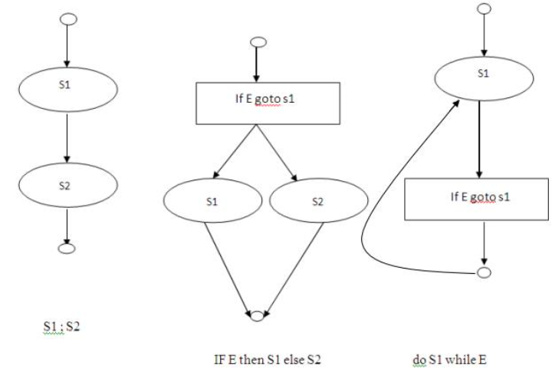
A definition d reaches a point p if there is a path from the point immediately following d to p and also d is not “killed”.

Slide 20
gen[S]- The set of definitions generated by S. It is the set of definitions that reach the end of S without following paths outside S.
kill[S]- is the set of definitions that never reach the end of S.
In[S]-Input of S
Out[S]-output of S. This takes into account the paths outside S also

Slide 21
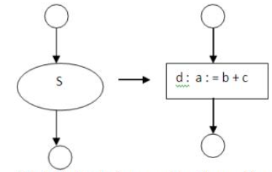

Data-flow analysis of structured programs

Slide 22
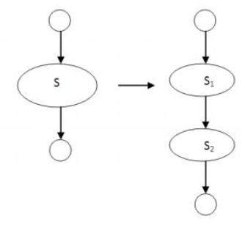
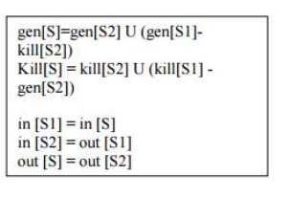

Slide 23
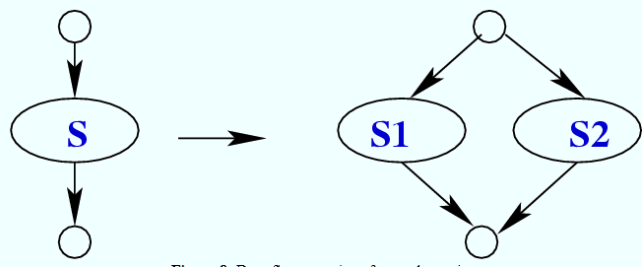
Gen (S)= gen (S1) U Gen(s2)
Kill (S)=Kill (S1) U Kill (S2)
In (S1)=in (S)
In(S2)=in(S)
Out(S)= out (S1) U out (S2)

Slide 24
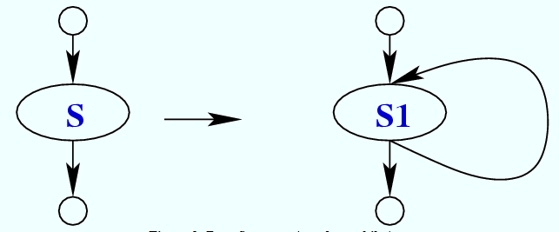
Gen (S)= gen (S1)
Kill (S)=Kill (S1)
In (S1)=in (S) U gen (S1)
Out(S)= out (S1)

Slide 25
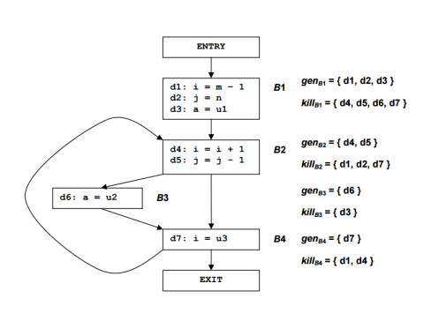
Example for reaching definitions

Slide 26
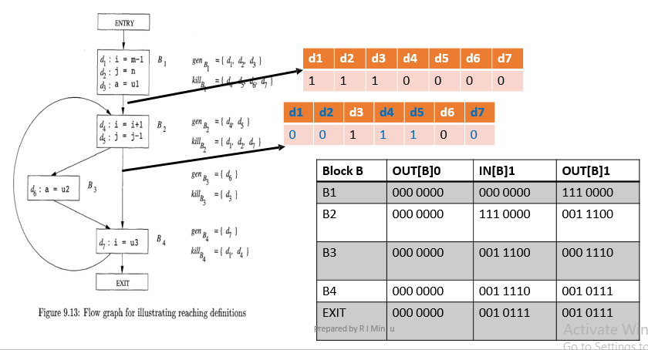
Example for reaching definitions

Slide 27
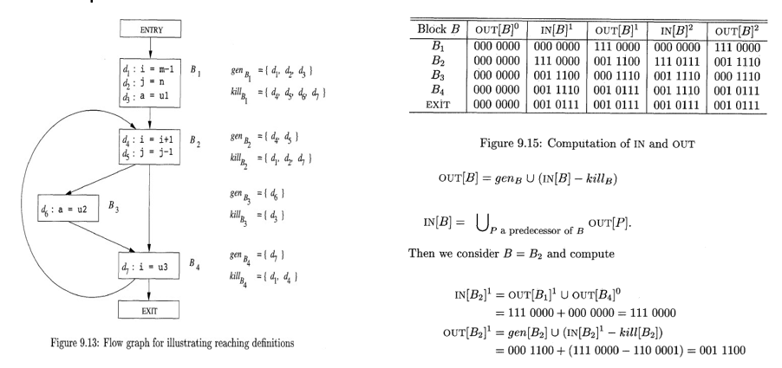

Slide 28
At the end of the first pass, 0UT[B2]1 = 001 1100, reflecting the fact that d4 and d5 are generated in B2, while d3 reaches the beginning of B2 and is not killed in B2.
Notice that after the second round, 0UT[B2] has changed to reflect the fact that d6 also reaches the beginning of B2 and is not killed by B2.
We did not learn that fact on the first pass, because the path from d6 to the end of B2, which is B3 ◊B4 ◊ B2, is not traversed in that order by a single pass.
That is, by the time we learn that d6 reaches the end of B4, we have already computed IN[B2] and OUT[B2] on the first pass.

Slide 29
Local reaching definitions
Save information only at certain points.
Instead of saving in points , it could be done for basic blocks.
Use Definition Chains (ud-chains)
Storing reaching definitions
It is a list which stores for each use of a variable, of all the definitions that reaches that use.

Slide 30
Evaluation order
This will be a problem in gen, kill, in and out sets for statements that has dependencies.
After choosing an evaluation order, we can release the space for a set after all uses of it have occurred.
General Control Flow
Data-flow analysis must take all control paths into account.
When programs can contain goto, break, continue statements then there will be modification in the actual control paths.

Slide 31
RUN TIME ENVIRONMENTS
SOURCE LANGUAGE ISSUES
Procedures
Activation trees
Control stack
Scope of declaration
Binding of names

Slide 32
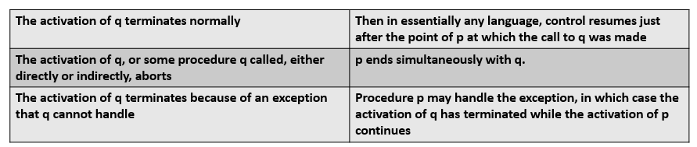
Procedure activations
Procedure activations are nested in time.
If an activation of procedure p calls procedure q, then that activation of q must end before the activation of p can end.
There are three common cases:

Slide 33
Activation Trees
The activations of procedures during the running of an entire program can be represented as tree structure called as activation tree.
In the tree each node corresponds to one activation.
The root is the activation of the "main" procedure that initiates execution of the program.
At a node for an activation of procedure p, the children correspond to activations of the procedures called by this activation of p.
We show these activations in the order that they are called, from left to right.
Notice that one child must finish before the activation to its right can begin.

Slide 34
Activation Trees
The activations of procedures during the running of an entire program can be represented as tree structure called as activation tree.
In the tree each node corresponds to one activation.
The root is the activation of the "main" procedure that initiates execution of the program.
At a node for an activation of procedure p, the children correspond to activations of the procedures called by this activation of p.
We show these activations in the order that they are called, from left to right.
Notice that one child must finish before the activation to its right can begin.

Slide 35
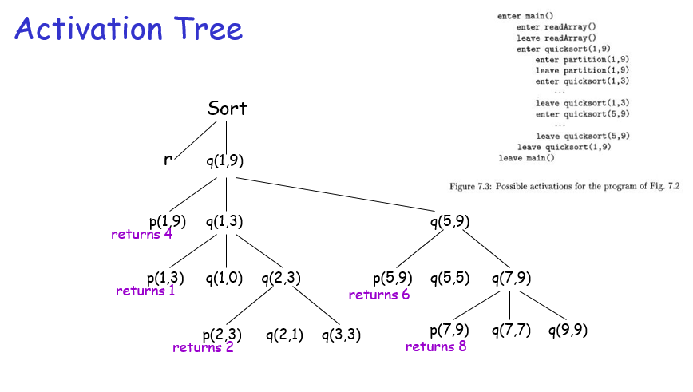

Slide 36
Control stack
Flow of control in program corresponds to depth first traversal of activation tree
Use a stack called control stack to keep track of live procedure activations
Push the node when activation begins and pop the node when activation ends
When the node n is at the top of the stack the stack contains the nodes along the path from n to the root

Slide 37
Binding of names
Same name may denote different data objects at run time.
Data object is a storage location that holds values.
Environment is a function that maps a name to a storage location.
State refers to a function that maps a storage location to the value held there.
When an environment associates storage location s with a name x, we say that x is bound to s. This association is referred to as a binding of x.

Slide 38
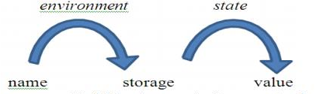
Binding of names

Slide 39
STORAGE ORGANISATION
The operating system maps the logical address into physical addresses.
The storage layout is influenced by the addressing constraints of the target machine.
A character array of length 10 needs only enough bytes to hold 10 characters, a compiler may allocate 12 bytes to get alignment, leaving 2 bytes unused.
This unused space due to alignment considerations is referred to as padding.
Activation records maintain the variable information.

Slide 40
STORAGE ORGANISATION
From the perspective of the compiler writer:
The executing target program runs in its own logical address space in which each program value has a location.
The management and organization of this logical address space is shared between the compiler, operating system, and target machine.
The operating system maps the logical addresses into physical addresses, which are usually spread throughout memory.

Slide 41
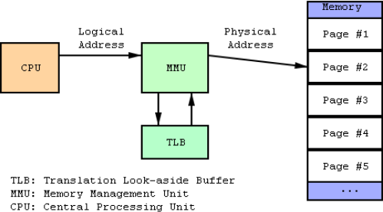
BASIS FOR COMPARISON | LOGICAL ADDRESS | PHYSICAL ADDRESS
Basic | It is the virtual address generated by CPU | The physical address is a location in a memory unit.
Address Space | Set of all logical addresses generated by CPU in reference to a program is referred as Logical Address Space. | Set of all physical addresses mapped to the corresponding logical addresses is referred as Physical Address.
Visibility | The user can view the logical address of a program. | The user can never view physical address of program
Access | The user uses the logical address to access the physical address. | The user can not directly access physical address.

Slide 42
STORAGE ALLOCATION STRATEGIES
A statically determined area Code that holds the executable target code. The size of the target code can be determined at compile time.
A statically determined data area Static for holding global constants and other data generated by the compiler. The size of the global constants and compiler data can also be determined at compile time.
A dynamically managed area Heap for holding data objects that are allocated and freed during program execution. The size of the Heap cannot be determined at compile time.
A dynamically managed area Stack for holding activation records as they are created and destroyed during procedure calls and returns. Like the Heap, the size of the Stack cannot be determined at compile time.

Slide 43
STORAGE ALLOCATION STRATEGIES
Three strategies
Static allocation
Stack allocation
Heap allocation
HEAP ALLOCATION
Stack allocation strategy cannot be used when
1. The values of local names must be retained when an activation ends.
2. A called activation outlives the caller.

Slide 44
Heap allocation uses pieces of contiguous storage, as demanded by activation records or other objects.
The memory may be deallocated in any order, so over the time the heap will consist of alternate areas that are free and in use.
The heap is the portion of the store that is used for data that lives indefinitely, or until the program explicitly deletes
Memory Manager: The memory manager keeps track of all the free space in heap storage at all times. It performs two basic functions

Slide 45
Heap (…)
Allocation. When a program requests memory for a variable or object, the memory manager produces a chunk of contiguous heap memory of the requested size. If space is exhausted, the memory manager passes that information back to the application program
Deallocation. The memory manager returns deallocated space to the pool of free space, so it can reuse the space to satisfy other allocation requests.

Slide 46
Required properties of memory management in heap
Space Efficiency. A memory manager should minimize the total heap space needed by a program
Program Efficiency. A memory manager should make good use of the memory subsystem to allow programs to run faster. By attention to the placement of objects in memory, the memory manager can make better use of space and, hopefully, make the program run faster
Low Overhead. Because memory allocations and deallocations are frequent operations in many programs, it is important that these operations be as efficient as possible

Slide 47
Activation Records
Procedure calls and returns are usually managed by a run-time stack called the control stack. Each live activation has an activation record.
The root of the activation tree will be at the bottom of the stack
The entire sequence of activation records on the stack corresponding to the path in the activation tree to the activation where control currently resides.
The latter activation has its record at the top of the stack

Slide 48
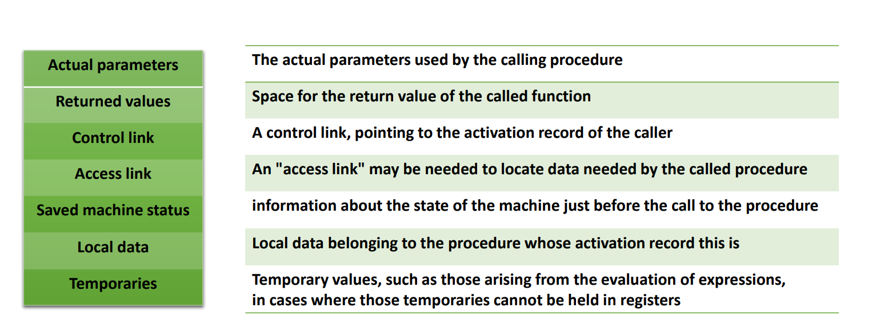

Slide 49
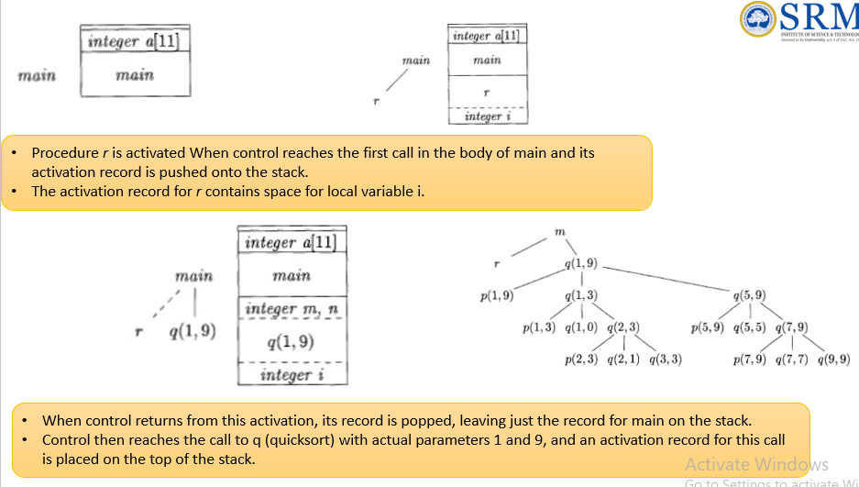

Slide 50
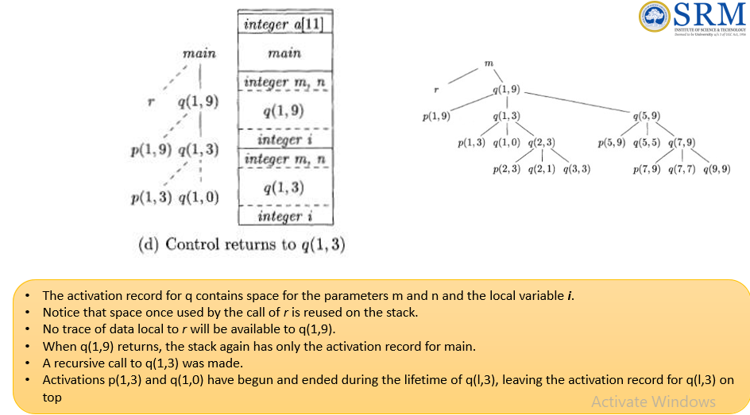

Slide 51
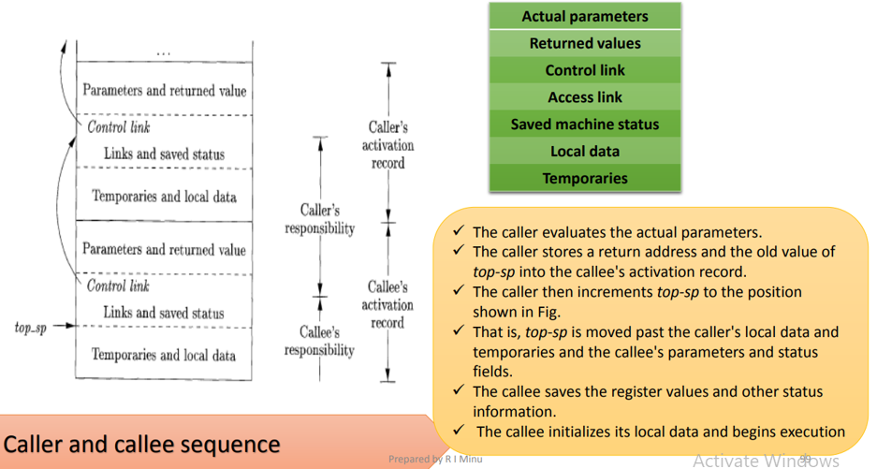

Slide 52
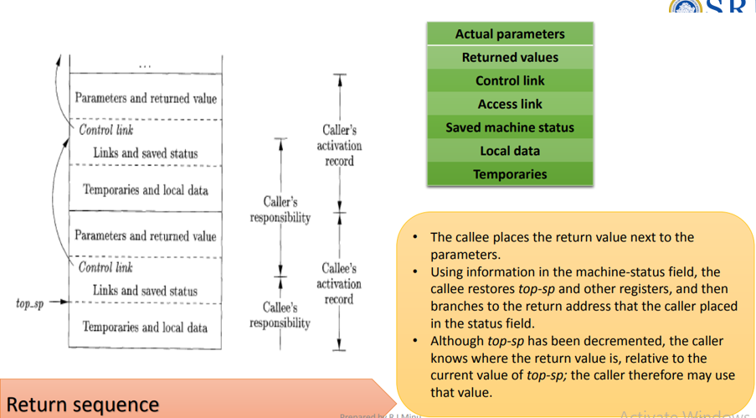

Slide 53
Variable-Length Data on the Stack
The run-time memory-management system must deal frequently with the allocation of space for objects the sizes of which are not known at compile time
But which are local to a procedure and thus may be allocated on the stack.
In modern languages, objects whose size cannot be determined at compile time are allocated space in the heap

Slide 54
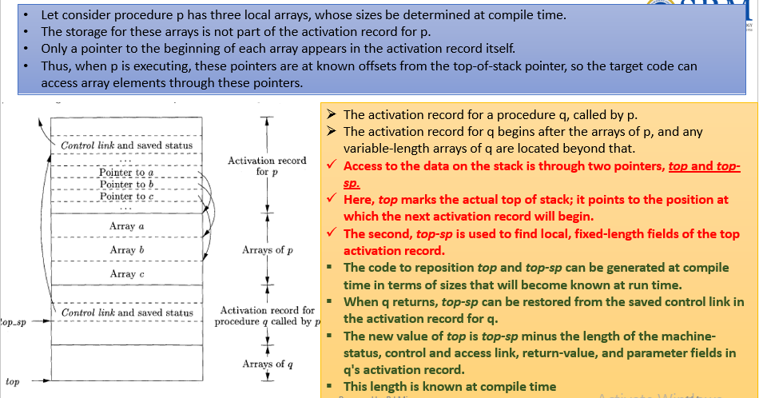

Slide 55
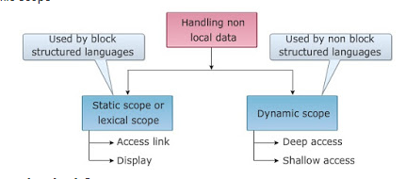
ACCESS TO NON LOCAL NAMES
Now let us see how a procedure access their data that not belong to its own
That is the mechanism for finding data used within a procedure p but that does not belong to p.
Access becomes more complicated in languages where procedures can be declared inside other procedures.
There are two types of scope rules, for the non-local names- Static scope and Dynamic scope.

Slide 56
Static or Lexical Scope
Here , scope is verified by examining the text of the program.
Eg-PASCAL, C and ADA -block structured languages.
Block –This defines a new scope with a sequence of statements that contains the local data declarations. It is enclosed within the delimiters.

Slide 57
Data Access Without Nested Procedures
The global variable v has a scope consisting of all the functions that follow the declaration of v, except where there is a local definition of the identifier v.
For languages that do not allow nested procedure declarations, allocation of storage for variables and access to those variables is simple
Global variables are allocated static storage.
The locations of these variables remain fixed and are known at compile time.
So to access any variable that is not local to the currently executing procedure, we simply use the statically determined address.
Any other name must be local to the activation at the top of the stack.
We may access these variables through the top-sp pointer of the stack.

Slide 58
Data Access With Nested Procedures
Access becomes far more complicated when a language allows procedure declarations to be nested and also uses the normal static scoping rule;
Let us give nesting depth 1 to procedures that are not nested within any other procedure

Slide 59
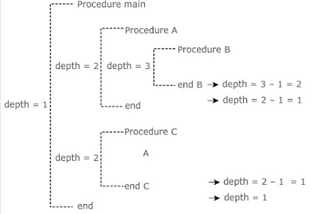
Lexical scope for nested procedures
Procedure main-> Procedure A -> Procedure B
Procedure main-> Procedure C

Slide 60
Blocks…
The beginning and end of the block are specified by the delimiter.
At a program point, declarations are visible
made inside the procedure
names of all enclosing procedures
names declared made immediately within such procedures
Block storage allocation is implemented by stack.
Lexical scope is implemented by nesting depth, access link and displays.

Slide 61
Nesting Depth
Lexical scope isimplemented by using nesting depth of a procedure.
The procedure of calculating nesting depth is as follows:
The main programs nesting depth is ‘1.
When a new procedure begins, add ‘1’ to nesting depth each time.
When you exit from a nested procedure, subtract ‘1’ from depth each time
The variable declared in specific procedure is associated with nesting depth.

Slide 62
Access Link:
Access links are pointer to each activation record.
If procedure p is nested within a procedure q then access link of p points to access link or most recent activation record of procedure q.
A direct implementation of the normal static scope rule for nested functions is obtained by adding a pointer called the access link to each activation record.
Note that the nesting depth of q must be exactly one less than the nesting depth of p.

Slide 63
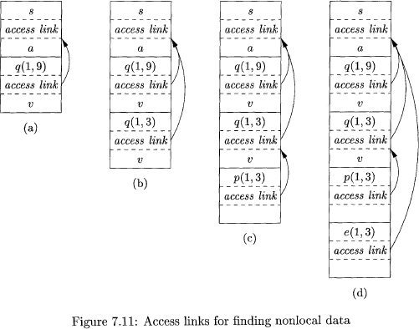
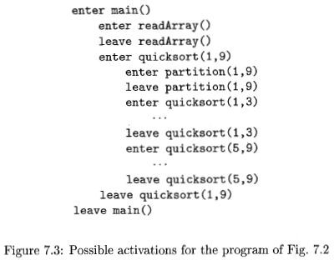
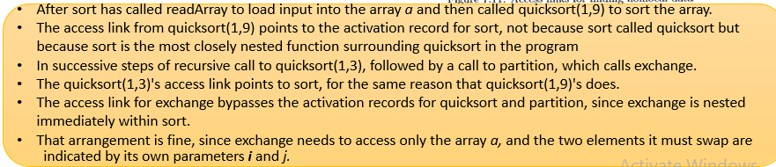

Slide 64
Parameter Passing
Call by value
actual parameters are evaluated and their r-values are passed to the called procedure
caller evaluates the actual parameters and places r value in the storage for
formals
call has no effect on the activation record of caller
Call by reference (call by address)
the caller passes a pointer to each location of actual parameters
if actual parameter is a name then l-value is passed
if actual parameter is an expression then it is evaluated in a new location and the address of that location is passed

Slide 65
Displays
Access links makes the computations slower.
Activation record can be accessed from direct location instead of pointers.
Display is a global array (d) of pointers to activation records, indexed by lexical nesting depth.
d[i] is an array element which points to the most recent activation of the block.
A nonlocal X is found in the following manner:
through one array access to find the activation record containing X.
Use relative address within the activation record

Slide 66
Displays
Access links makes the computations slower.
Activation record can be accessed from direct location instead of pointers.
Display is a global array (d) of pointers to activation records, indexed by lexical nesting depth.
d[i] is an array element which points to the most recent activation of the block.
A nonlocal X is found in the following manner:
through one array access to find the activation record containing X.
Use relative address within the activation record

Slide 67
